Slide 1

Guess the Topic
+
3103

Slide 2
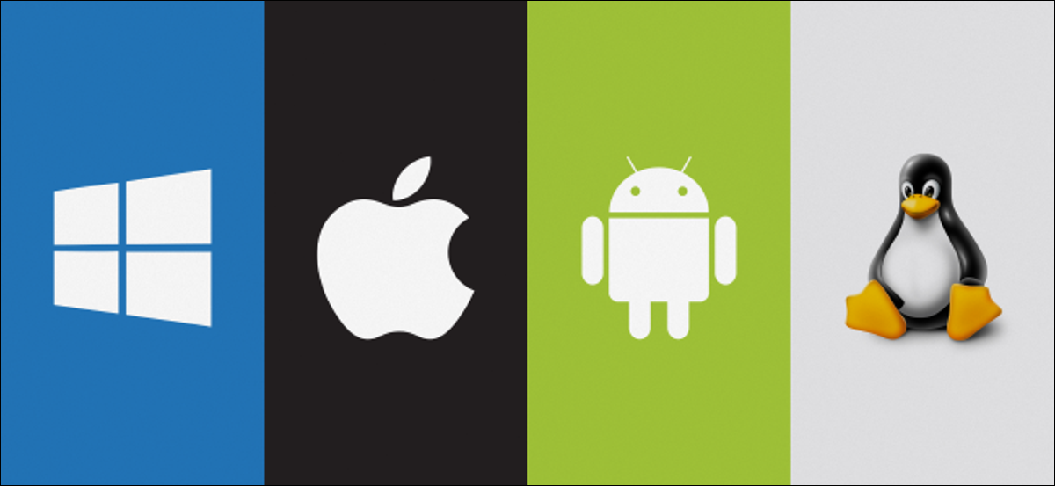
History of Operating System
Nazneen Akhter
Lecturer
Dept. of ICT, FST
Bangladesh University of Professionals
Notes:
https://www.slideshare.net/ImranMirza40/history-of-os

Slide 3
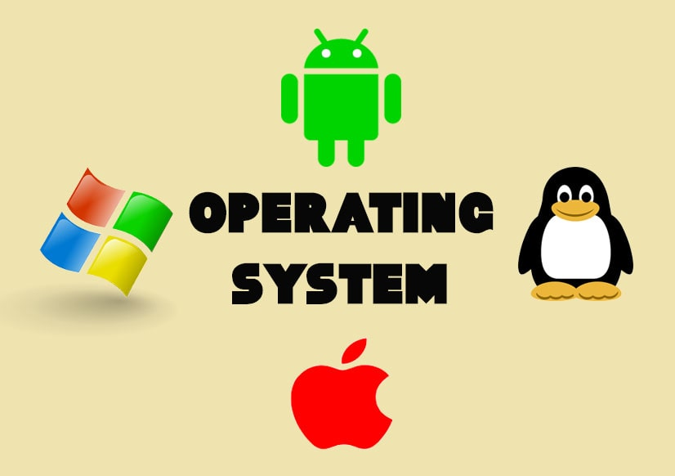
Operating System (OS)
It is a program that manages a computer’s hardware​
It acts as an intermediary between the computer user and the computer hardware​
It is a set of programs that manage computer hardware resources and provide common services for application software​

Slide 4
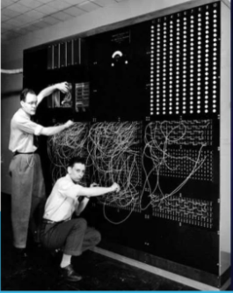
HISTORY
What were computers like before operating systems were invented?
In 1940’s (before Operating Systems) if you wanted to change what the computer was doing, you had to change how the wires were connected

Slide 5
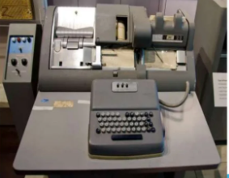
HISTORY (Cont.)
Later, instructions were given to the computer with punch cards or magnetic tape
If you wanted to run a different program, you had to wipe out the first program from memory and then load another program into memory.

Slide 6
HISTORY (Cont.)
In 1950s General Motors Research Laboratories implemented first operating system for IBM 701 computer.
That system was capable of executing one job at one time
A job is consist of set of program instructions corresponding to a particular computational task.

Slide 7
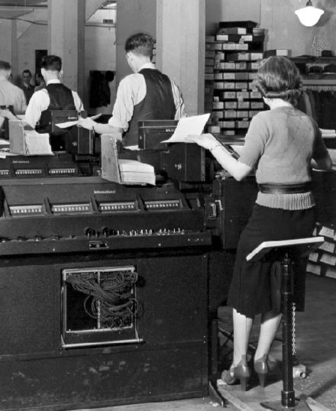
HISTORY (Cont.)
In 1960s, there was introduced batch-processing systems
The term "batch" is from batch processing, meaning "non- interactive execution“
A Batch file consist of series of command to be executed by command line interpreter
IBM Type 285 tabulators in use at U.S. Social Security Administration circa 1936

Slide 8
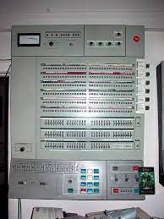
HISTORY (Cont.)
To run more than one program at a time, you need a "boss“ program that controls all the other programs
Such a boss program is called an operating system
OS/360 was used on most IBM mainframe computers beginning in 1966, including computers used by the Apollo program

Slide 9
HISTORY (Cont.)
In 1970s the system were primarily multimode multiprogramming that supported batch file processing, timesharing, and real time applications
In timesharing technique many people can use same computer system at same time
Real time is ability of operating system to provide required service in limited time

Slide 10
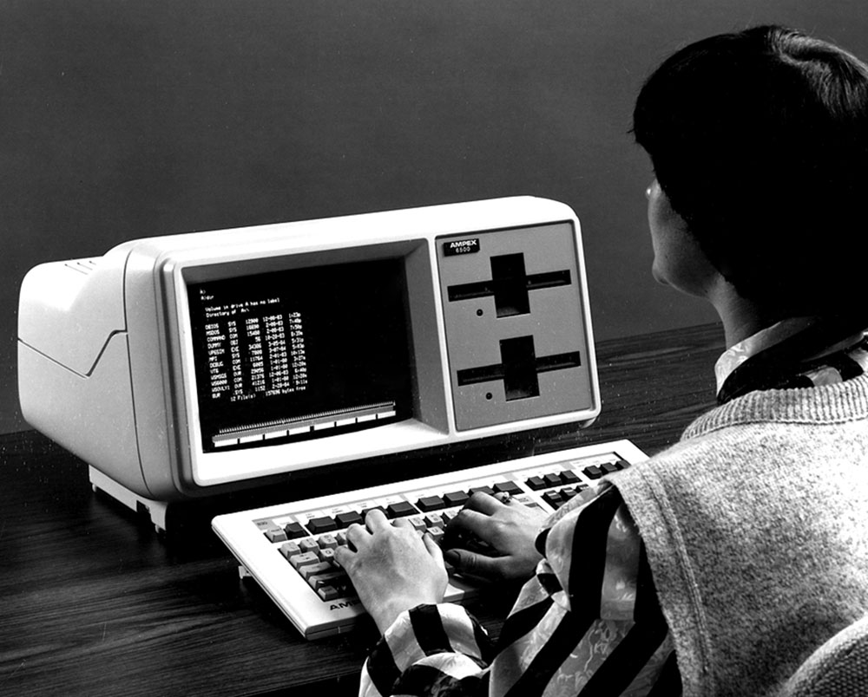
HISTORY (Cont.)
Microsoft’s MS-DOS was one of the first Operating Systems for Personal Computers (PCs)
No mouse. Instead, you had to type a lot of special computer commands

Slide 11
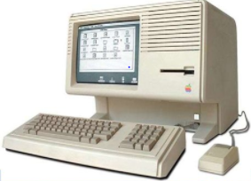
HISTORY (Cont.)
In the 1980s, operating systems were developed where you could move a mouse around and click on things instead of typing commands

Slide 12
HISTORY (Cont.)
In 1990s the creation of World Wide Web brought great change in industry
In this era systems were developed which could store gigabyte of information and execute million of instructions per second(MIPS)
Most software was created by writing source code in high level language but commercial software was as object code(machine code)

Slide 13
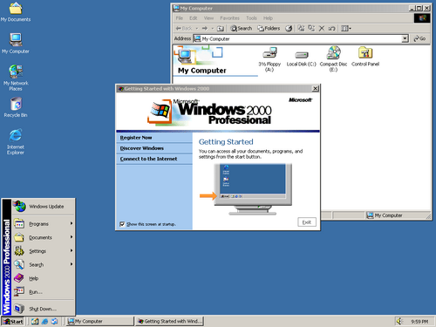
HISTORY (Cont.)
WINDOWS 2000 is an operating system for use on both client and server computers
It was produced by Microsoft and released to manufacturing on December 15, 1999

Slide 14
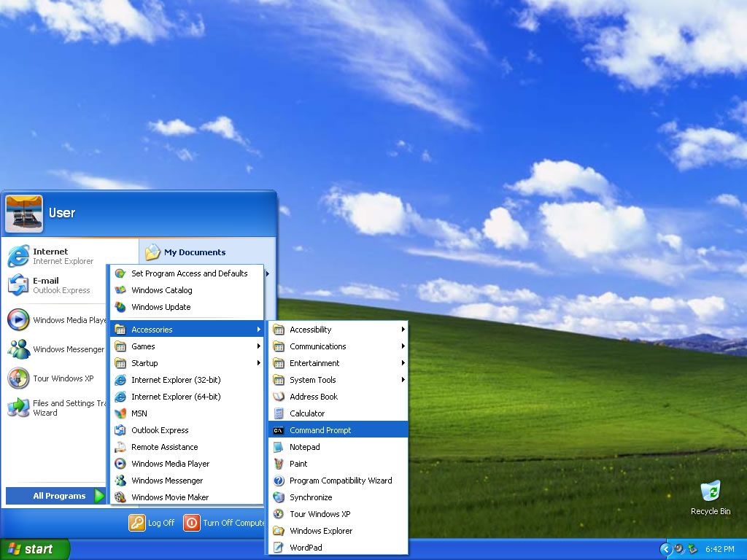
HISTORY (Cont.)
Windows XP (codenamed Whistler) is a personal computer operating system produced by Microsoft
The operating system was released to manufacturing on August 24, 2001

Slide 15
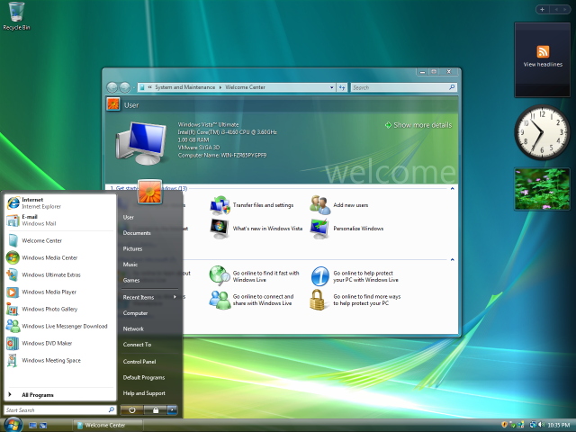
HISTORY (Cont.)
Windows Vista (codenamed Longhorn) is an operating system by Microsoft for use on personal computers, including home and business desktops, laptops, tablet PCs and media center PCs
Development was completed on 8,November 2006

Slide 16
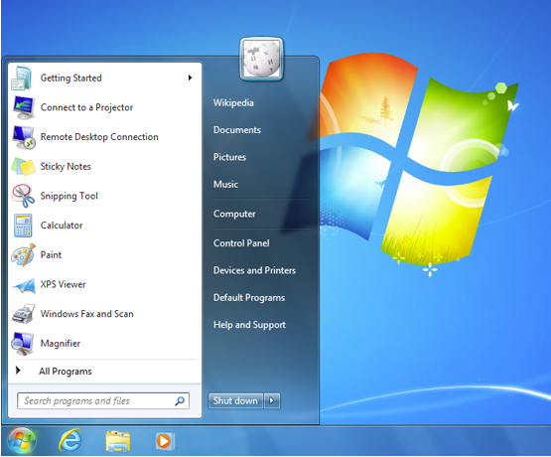
HISTORY (Cont.)
Windows 7 (codenamed Vienna, formerly Blackcomb) is a personal computer operating system developed by Microsoft
Windows 7 was released to manufacturing on 22 July 2009

Slide 17
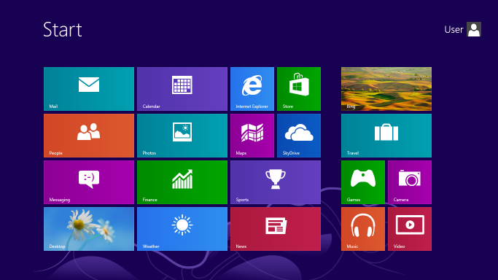
HISTORY (Cont.)
Windows 8 is a personal computer operating system developed by Microsoft as part of the Windows NT family of operating systems
The operating system was released to manufacturing on 1 August 2012

Slide 18
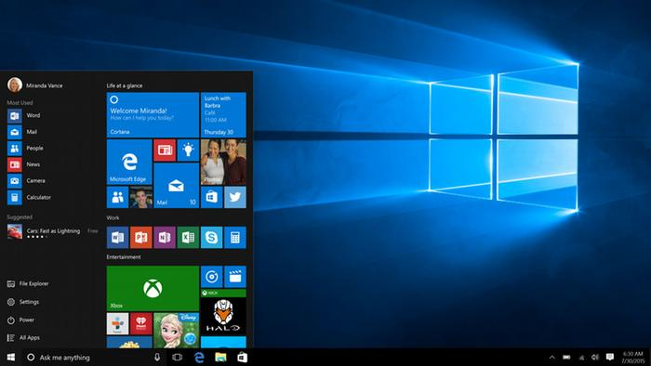
HISTORY (Cont.)
Windows 10 is a Personal Computer operating system developed by Microsoft as part of the Windows NT family of operating systems
Officially unveiled in September 2014

Slide 19
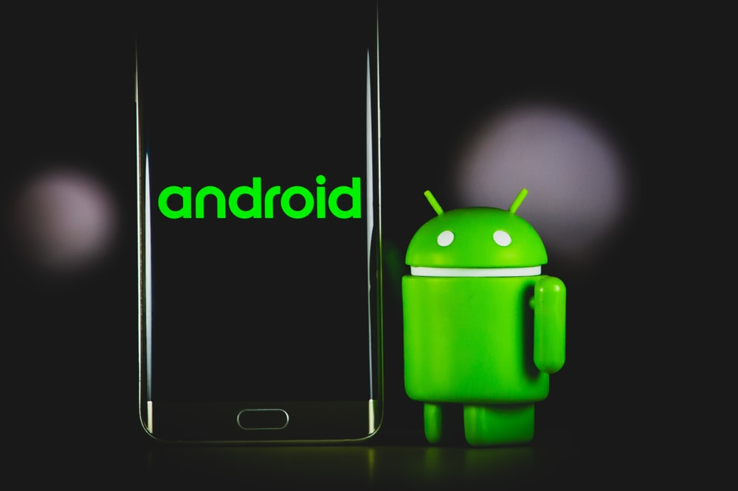
HISTORY (Cont.)
Android is a mobile operating system (OS) based on the Linux kernel and currently developed by Google
With a user interface based on direct manipulation, Android is designed primarily for touchscreen mobile
Initially developed by Android, Inc., which Google bought in 2005, Android was unveiled in 2007

Slide 20
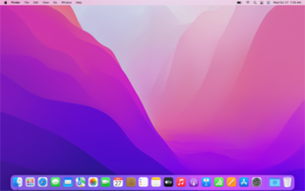
HISTORY (Cont.)
MAC OS is a proprietary graphical operating system developed and marketed by Apple Inc. since 2001
It is the primary operating system for Apple's Mac computers

Slide 21
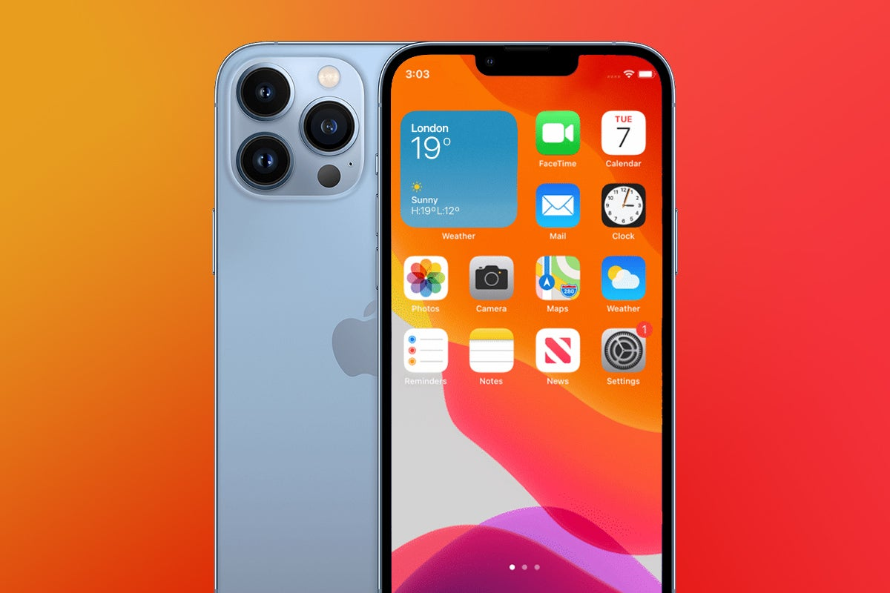
HISTORY (Cont.)
iOS is another type of operating system like ANDROID enables users to use Smartphones
The main credit of development of iOS’ development goes to Steve Jobs

